Slide 1

What's new:
Excel layouts for developers in
2024 release wave 1
Kennie Pontoppidan

Slide 2
Agenda
New reporting features in 2024 release wave 1
Translatable Excel reports
Calling Business Central APIs from Excel reports
New Excel reports in Business Central (preview)
Excel copilot (preview) on Business Central data

Slide 3
Abstract (hidden slide)
In this session, we will present new features for Excel layouts. Starting in version 23.3, you can develop reports with Excel layouts that translate to the users language when they run the report. You can also develop Excel reports that call Business Central REST APIs to augment the dataset defined in the report.

Slide 4
Translatable Excel reports

Slide 5
Static and runtime metadata worksheet (23.3)
Always have a (hidden) worksheet with
Report AL metadata
Request metadata
Request page filters
Report captions

Slide 6
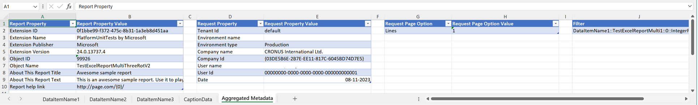
Report Metadata worksheet (23.3)
Runtime metadata
Enables API based (refreshable) Excel reports
Company/User/Report date easily available for author
Static metadata
Enables ”About this report” info for author

Slide 7
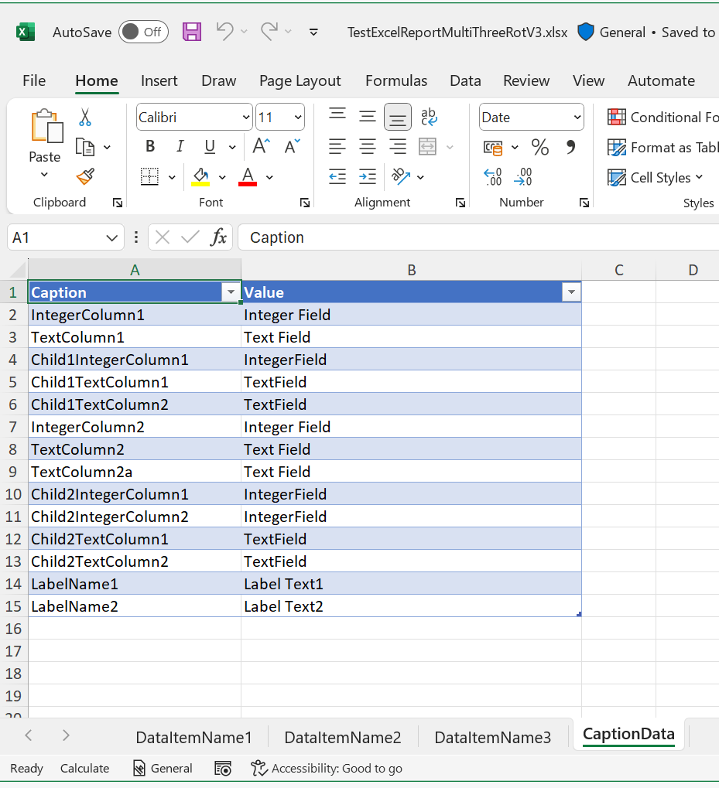
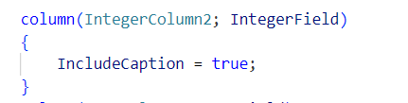
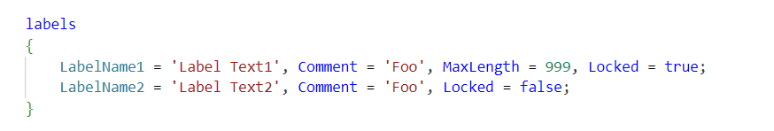
Caption data worksheet (23.3)

Slide 8

Translatable Excel layouts (23.3)
2
As a report author, you can use translation tags for
Worksheet names
Chart headers
Pivot elements
…
Server will replace tags when rendering the report.

Slide 9
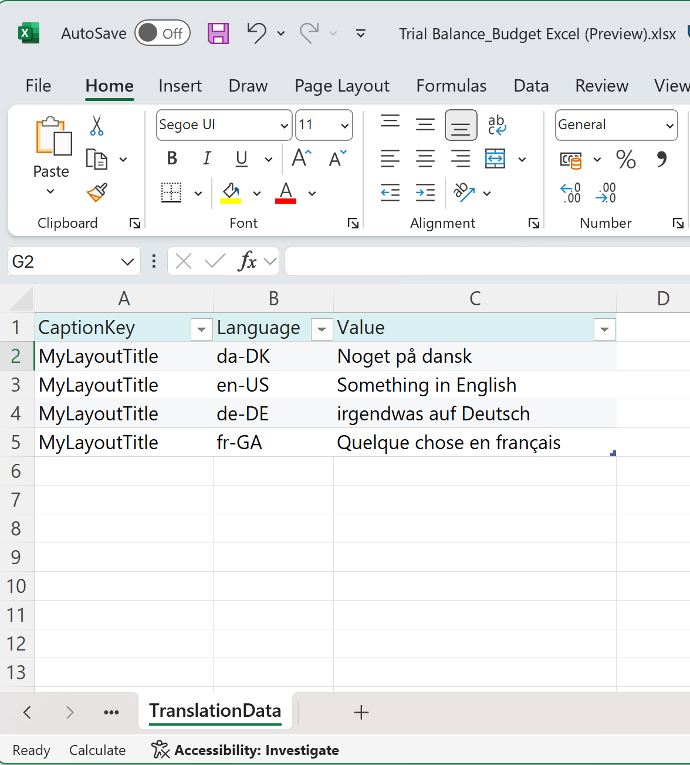
User defined TranslationData worksheet (23.3)

Slide 10
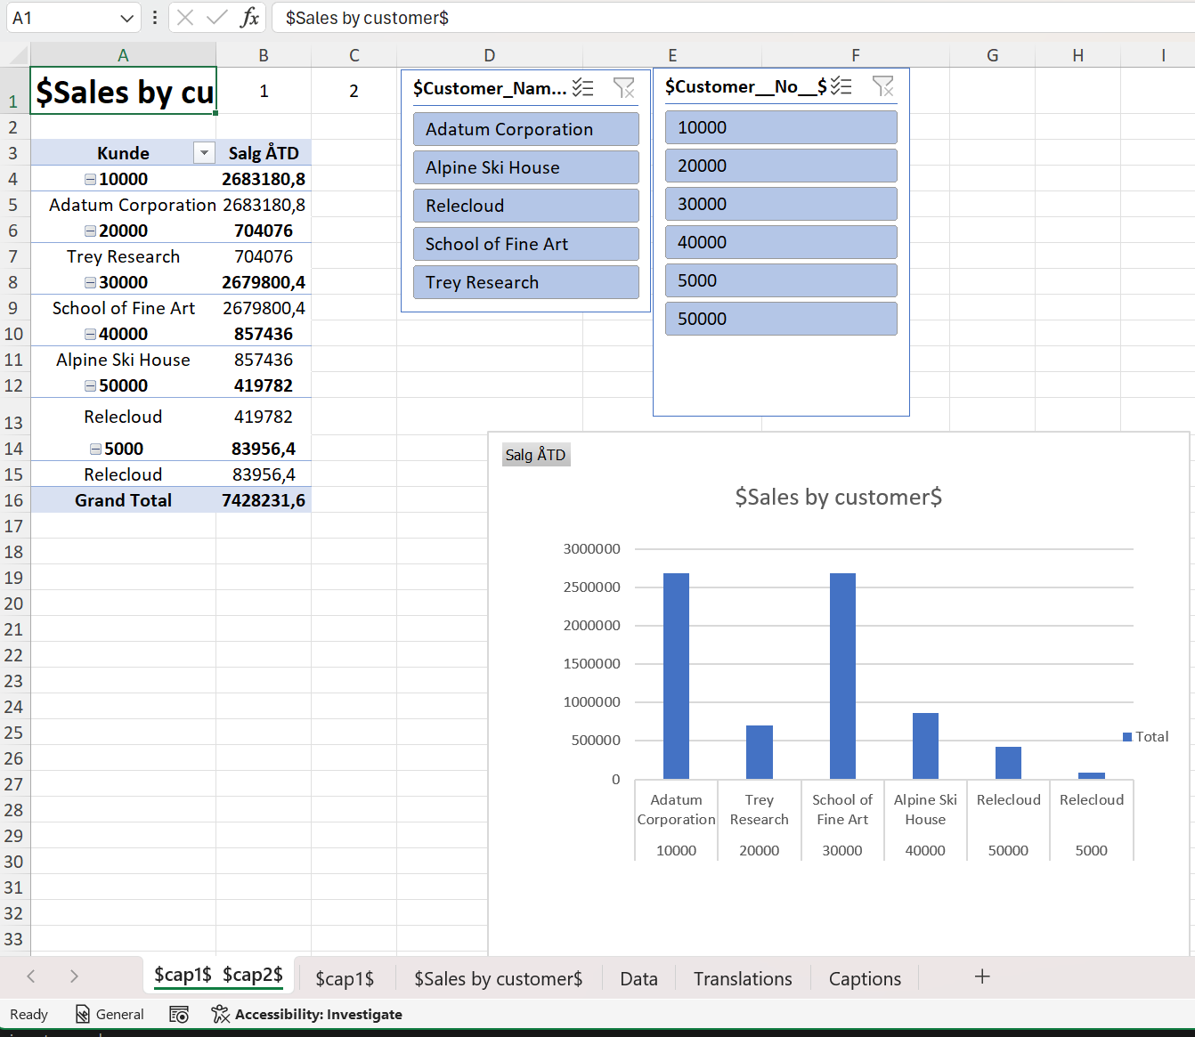
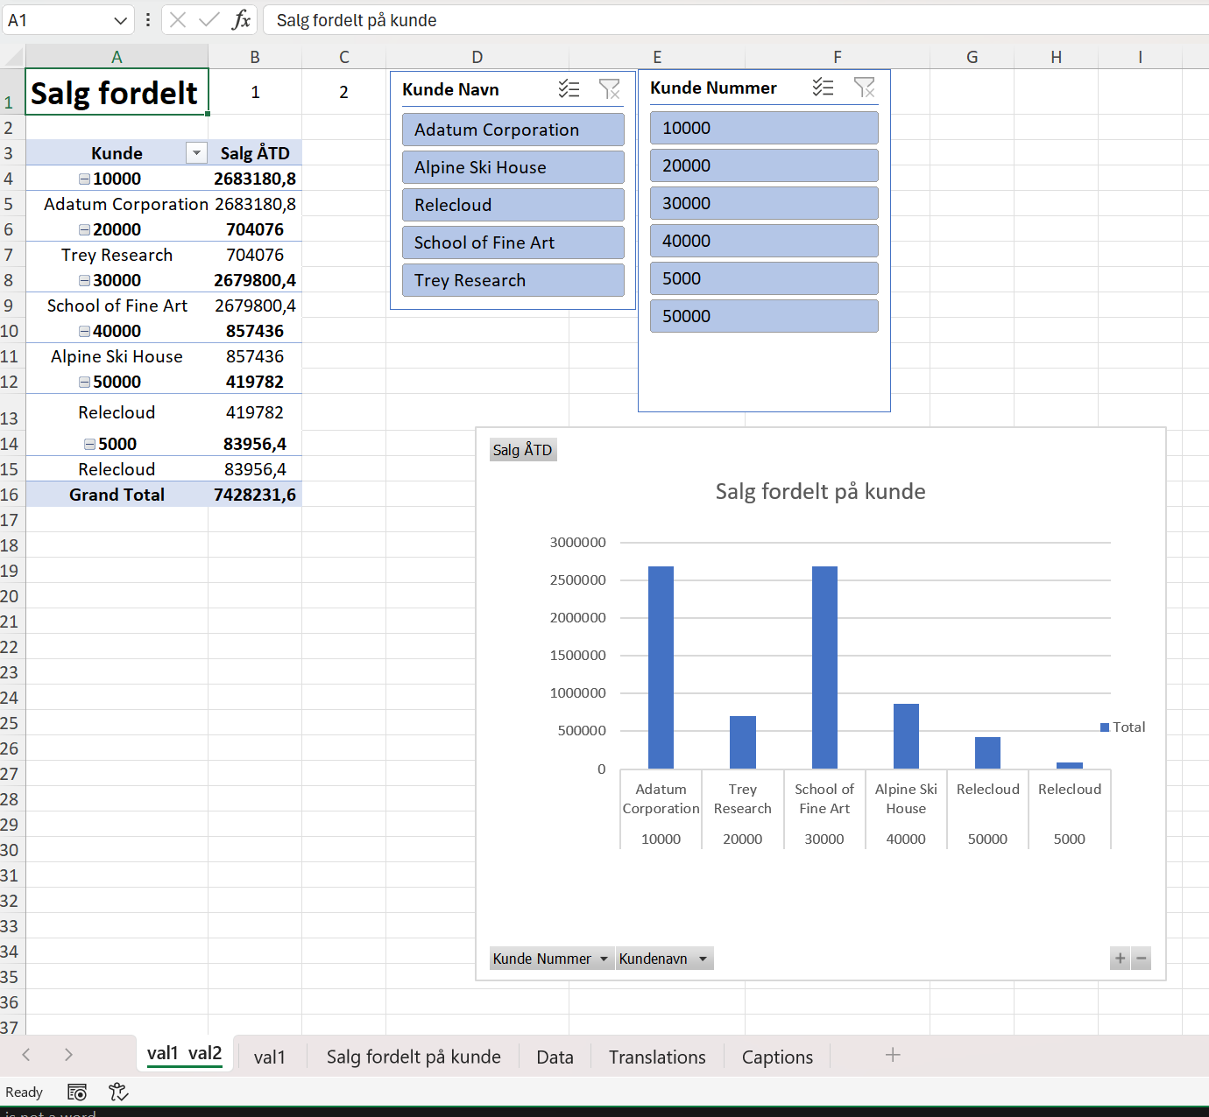
Translatable Excel layouts - example
Layout using $$ syntax
Report when user runs it

Slide 11
Calling Business Central APIs from Excel reports

Slide 12
Call APIs from Excel reports
2
Any API URI has this structure:
https://api.businesscentral.dynamics.com/v2.0/environment name/api/v2.0
And then each API adds
/companies({id})/agedAccountsPayables

Slide 13
On the Report Metadata worksheet…
Runtime metadata
Enables API based (refreshable) Excel reports

Slide 14
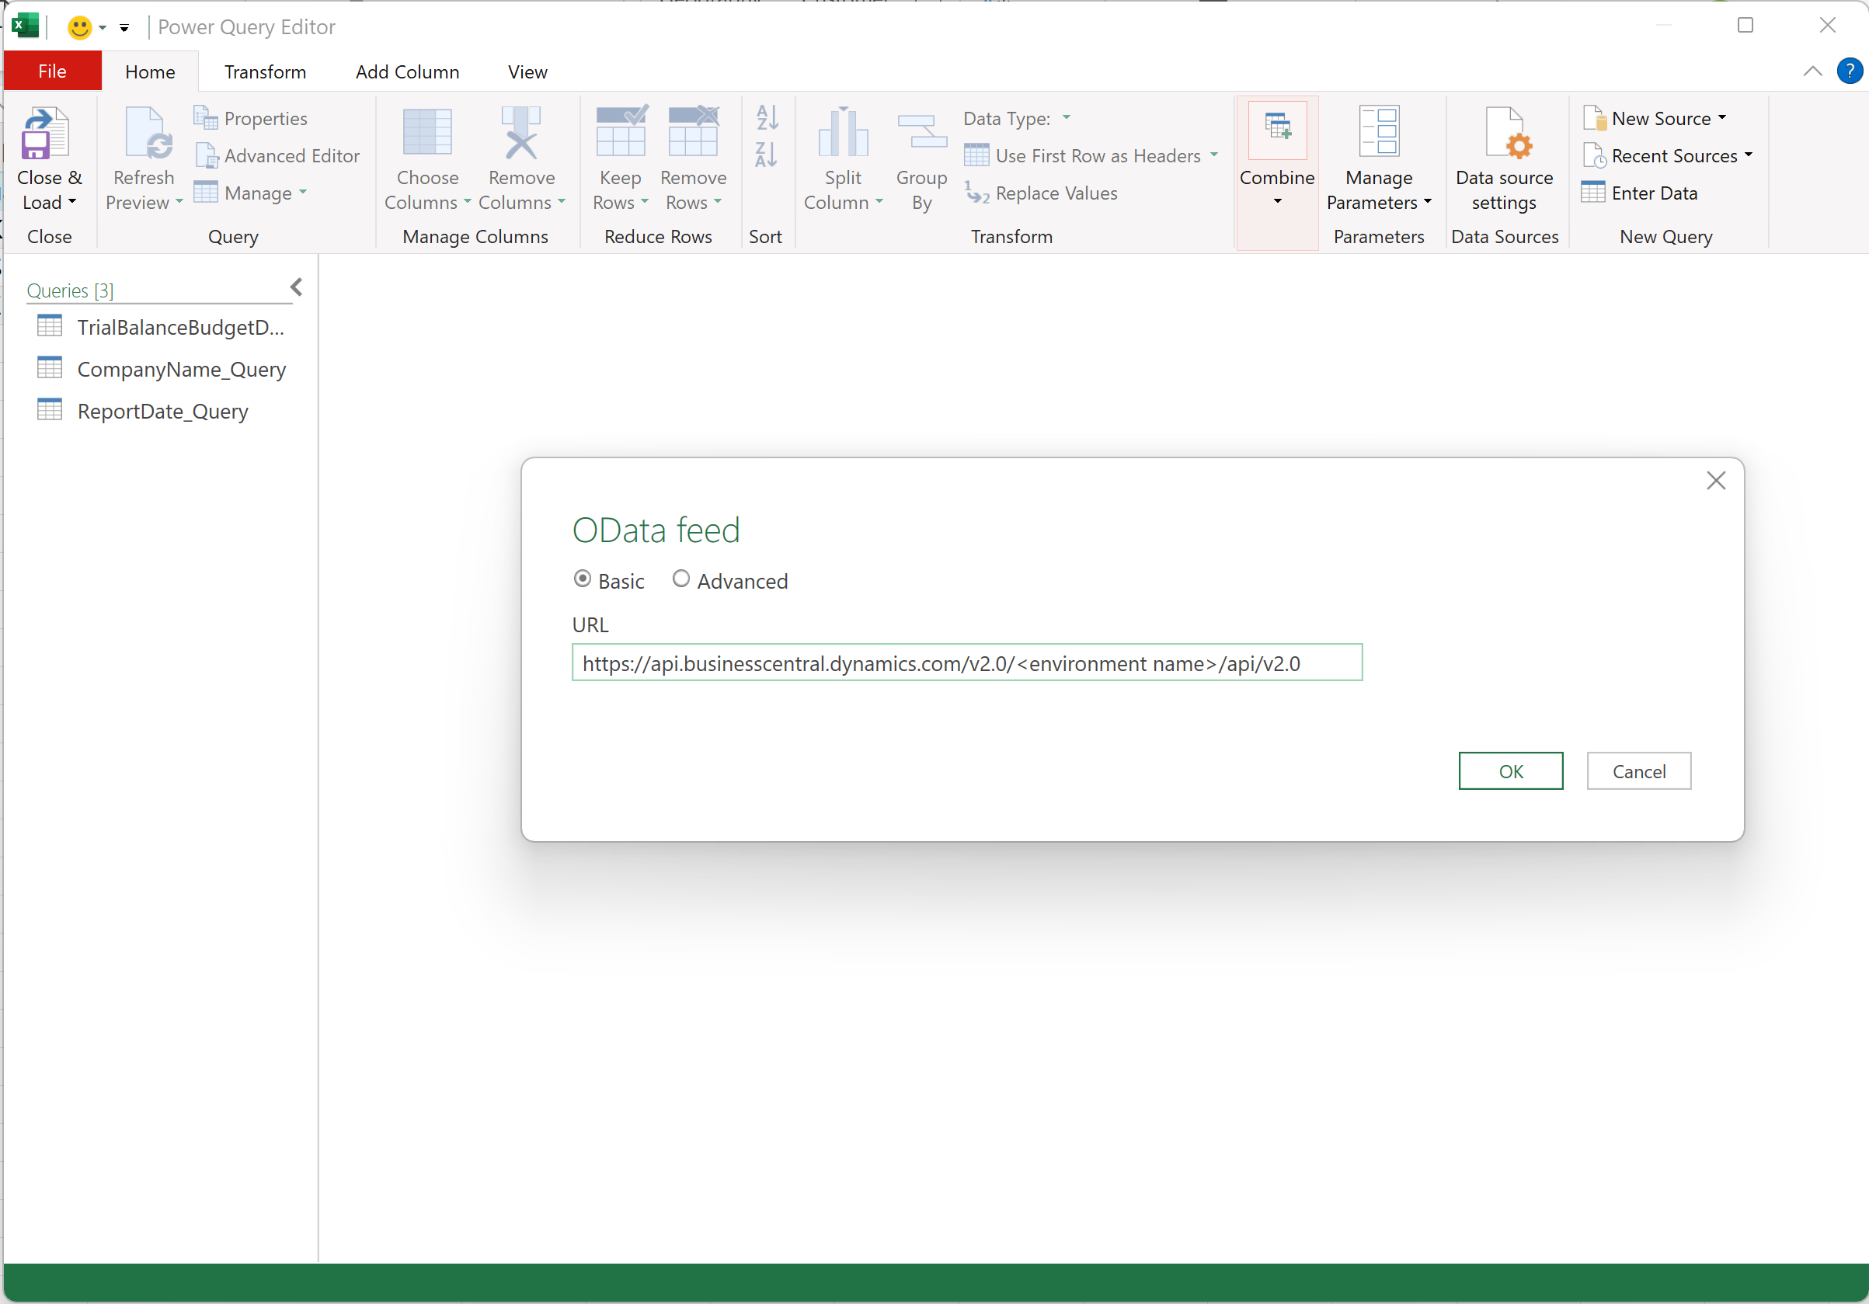
In Excel PowerQuery…
Notes:
let
URI = "https://services.odata.org/V4/TripPinService",
// URI = "https://api.businesscentral.dynamics.com/v2.0/environment name/api/v2.0",
Source = OData.Feed(URI)
in
Source

Slide 15
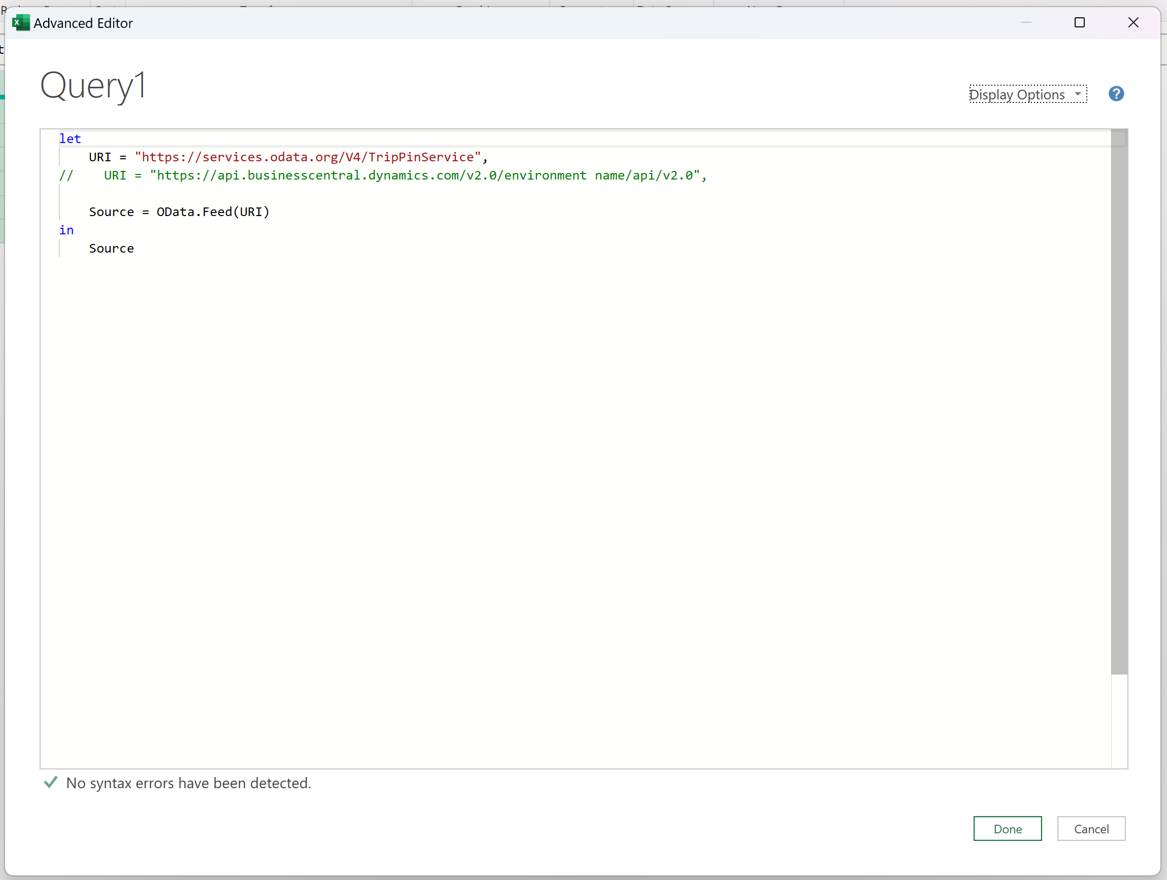
In PowerQuery Advanced Editor

Slide 16
New Excel reports in the base app (preview)

Slide 17
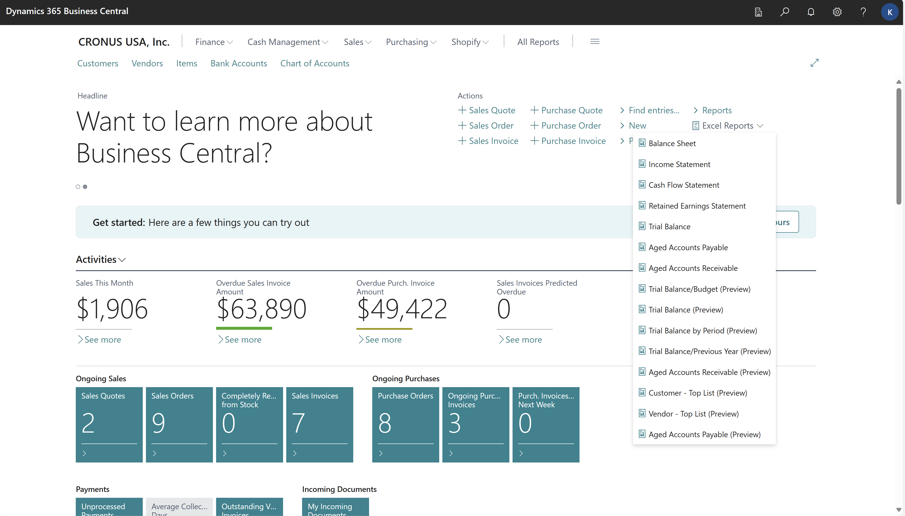

Slide 18
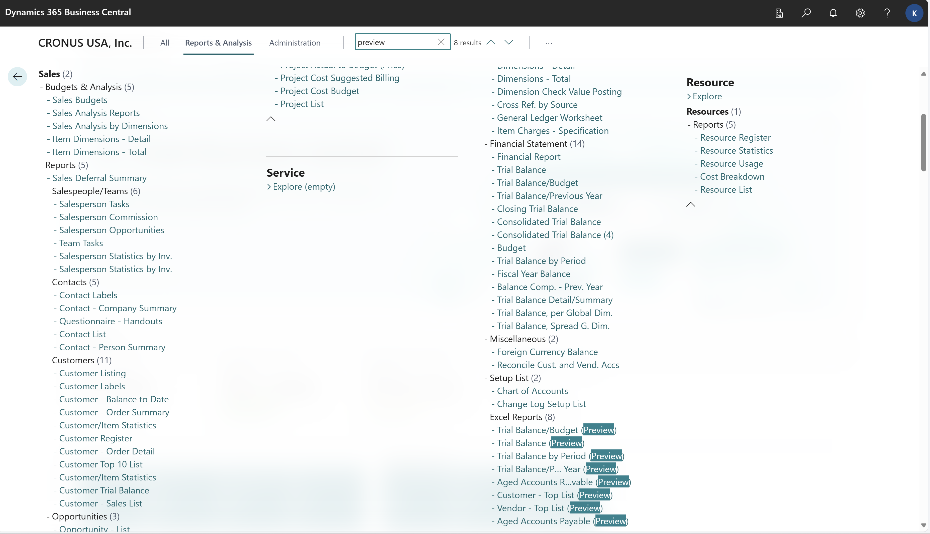

Slide 19
Demo
New Excel reports

Slide 20
Excel copilot (preview) on Business Central data

Slide 21
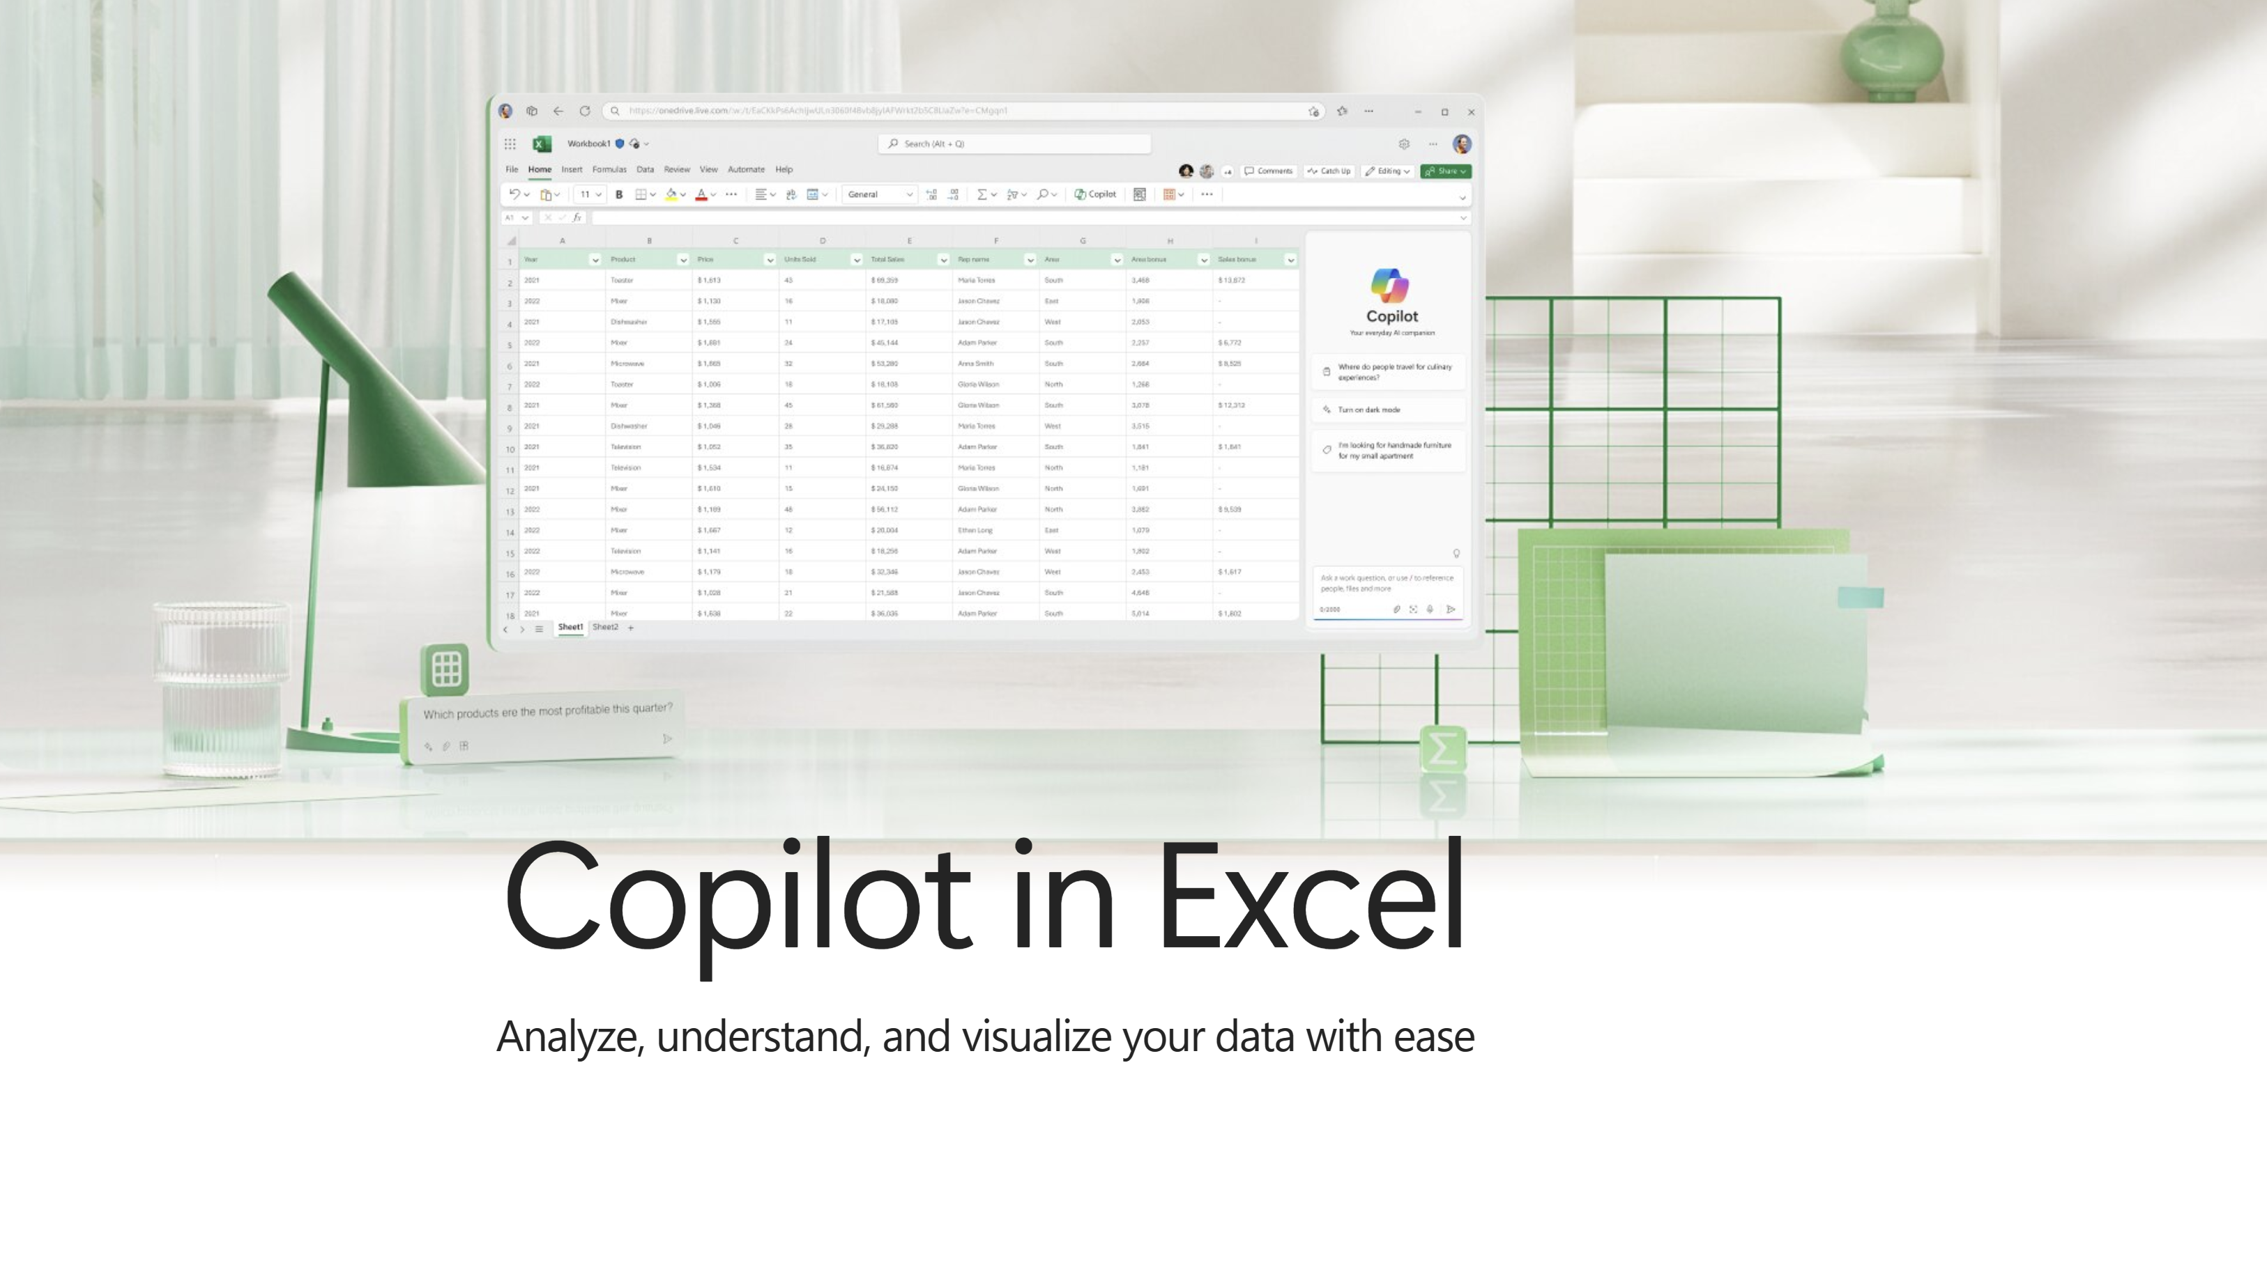
Notes:
Copilot in Excel help & learning (microsoft.com)

Slide 22
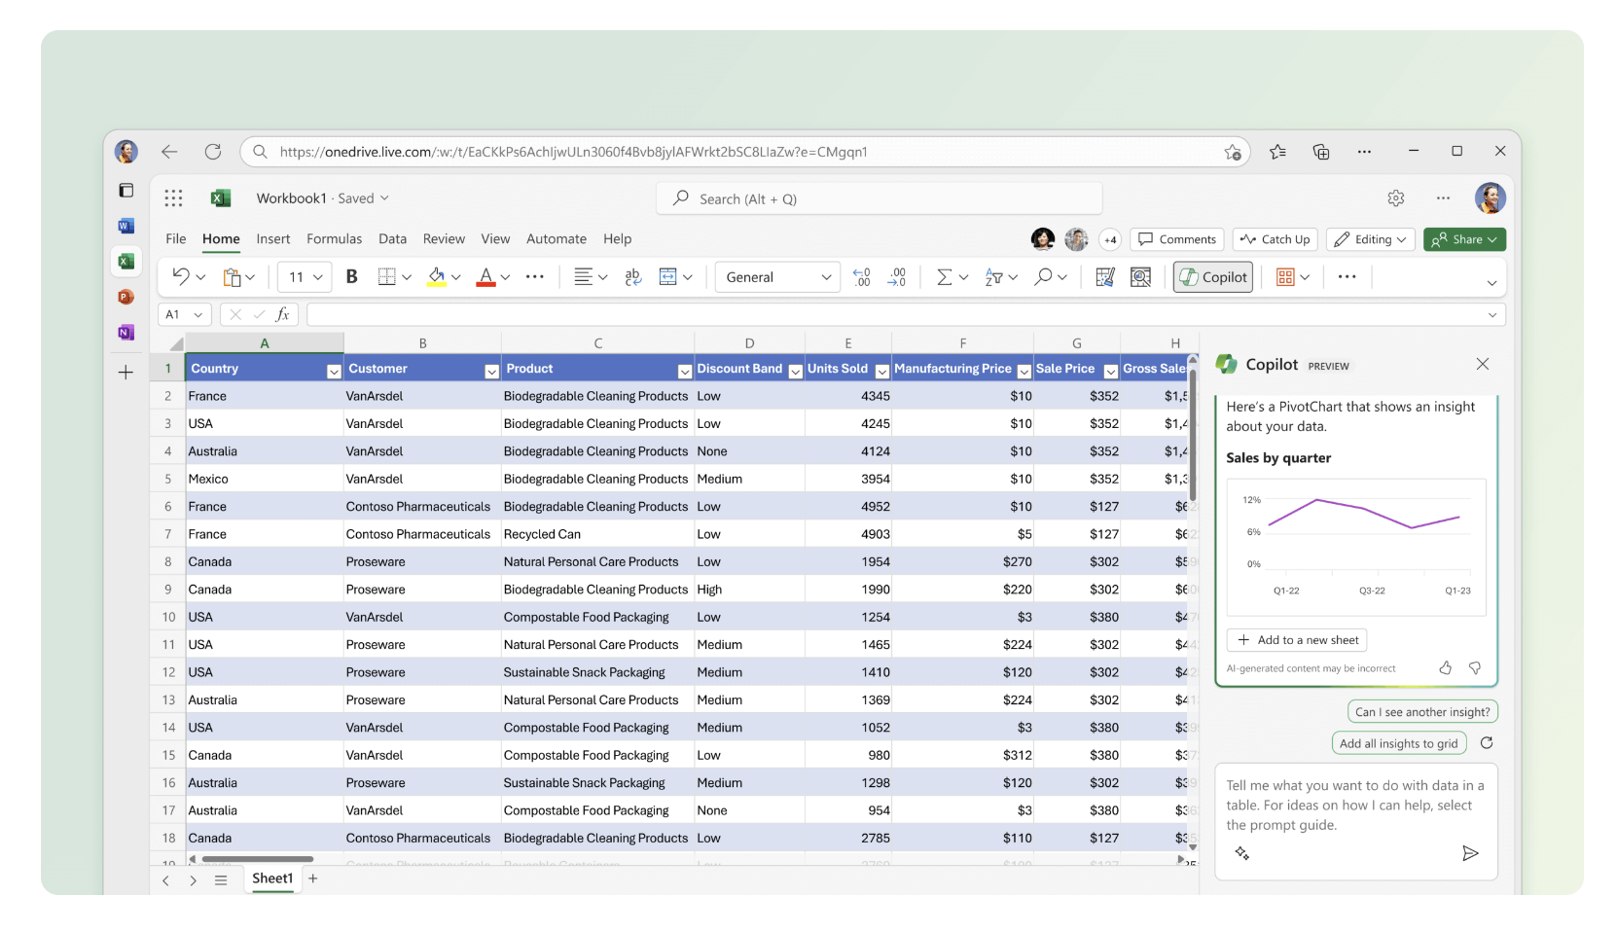
Go deeper with data Use Copilot to help you explore and understand your data better.

Slide 23
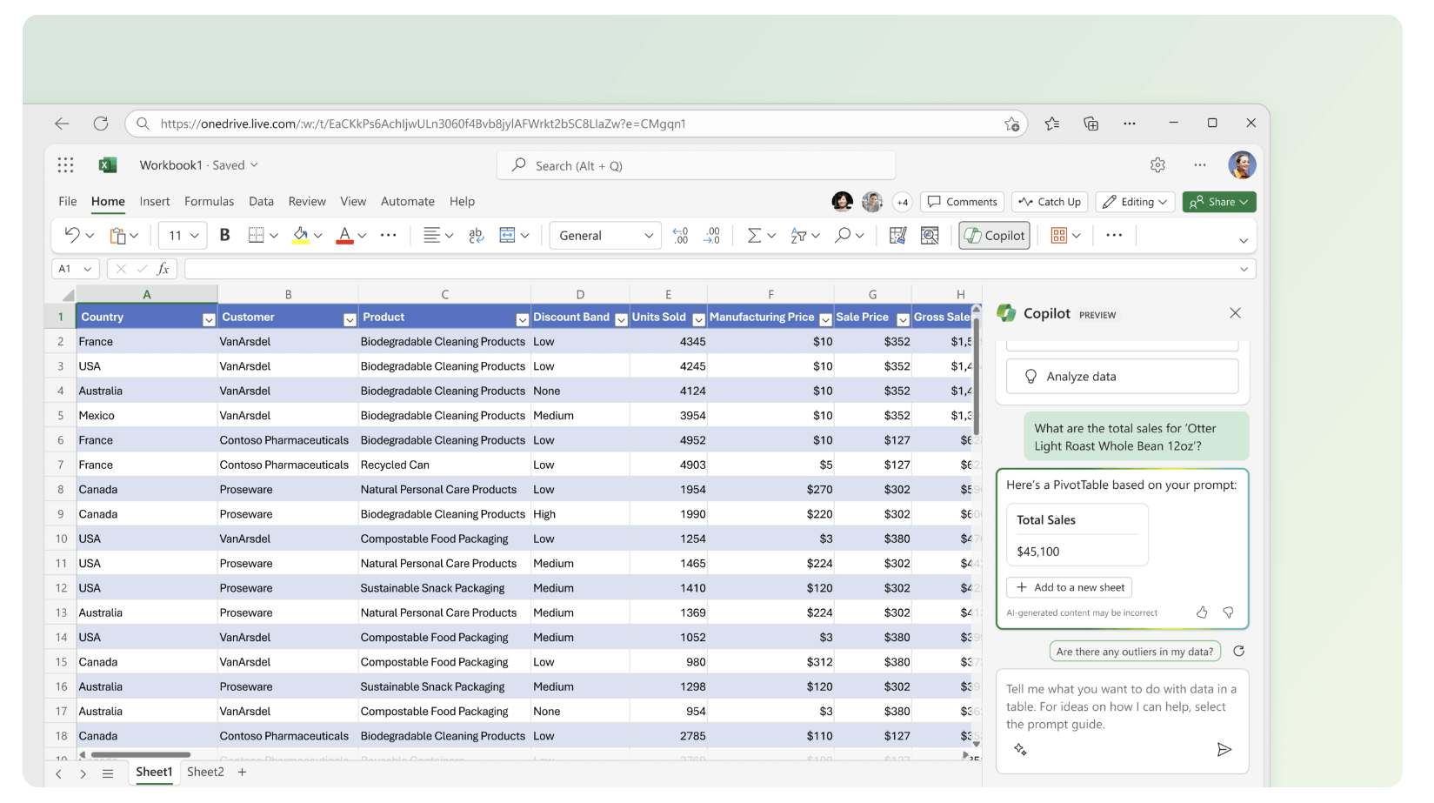
Identify insights Let Copilot help analyze and visualize your data.

Slide 24
Demo
Excel copilot on Business Central data

Slide 25
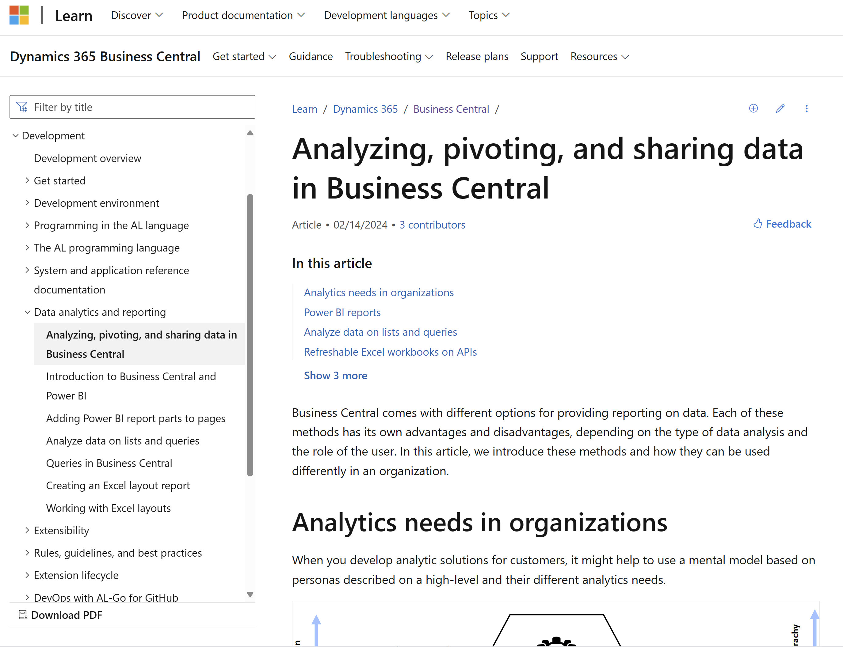
Want to learn more? aka.ms/bcDeveloper

Slide 26
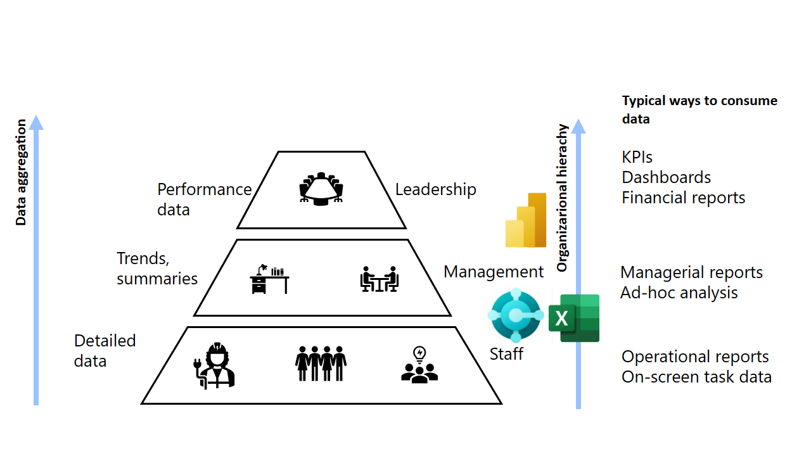
The BI triangle

Slide 27
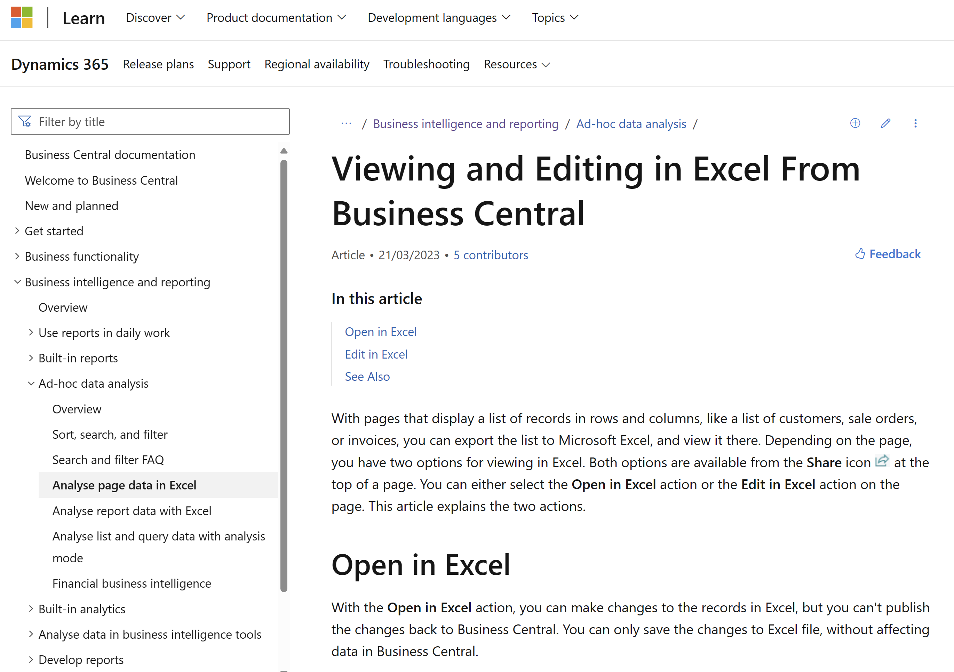
Want to learn more? aka.ms/bcReporting

Slide 28
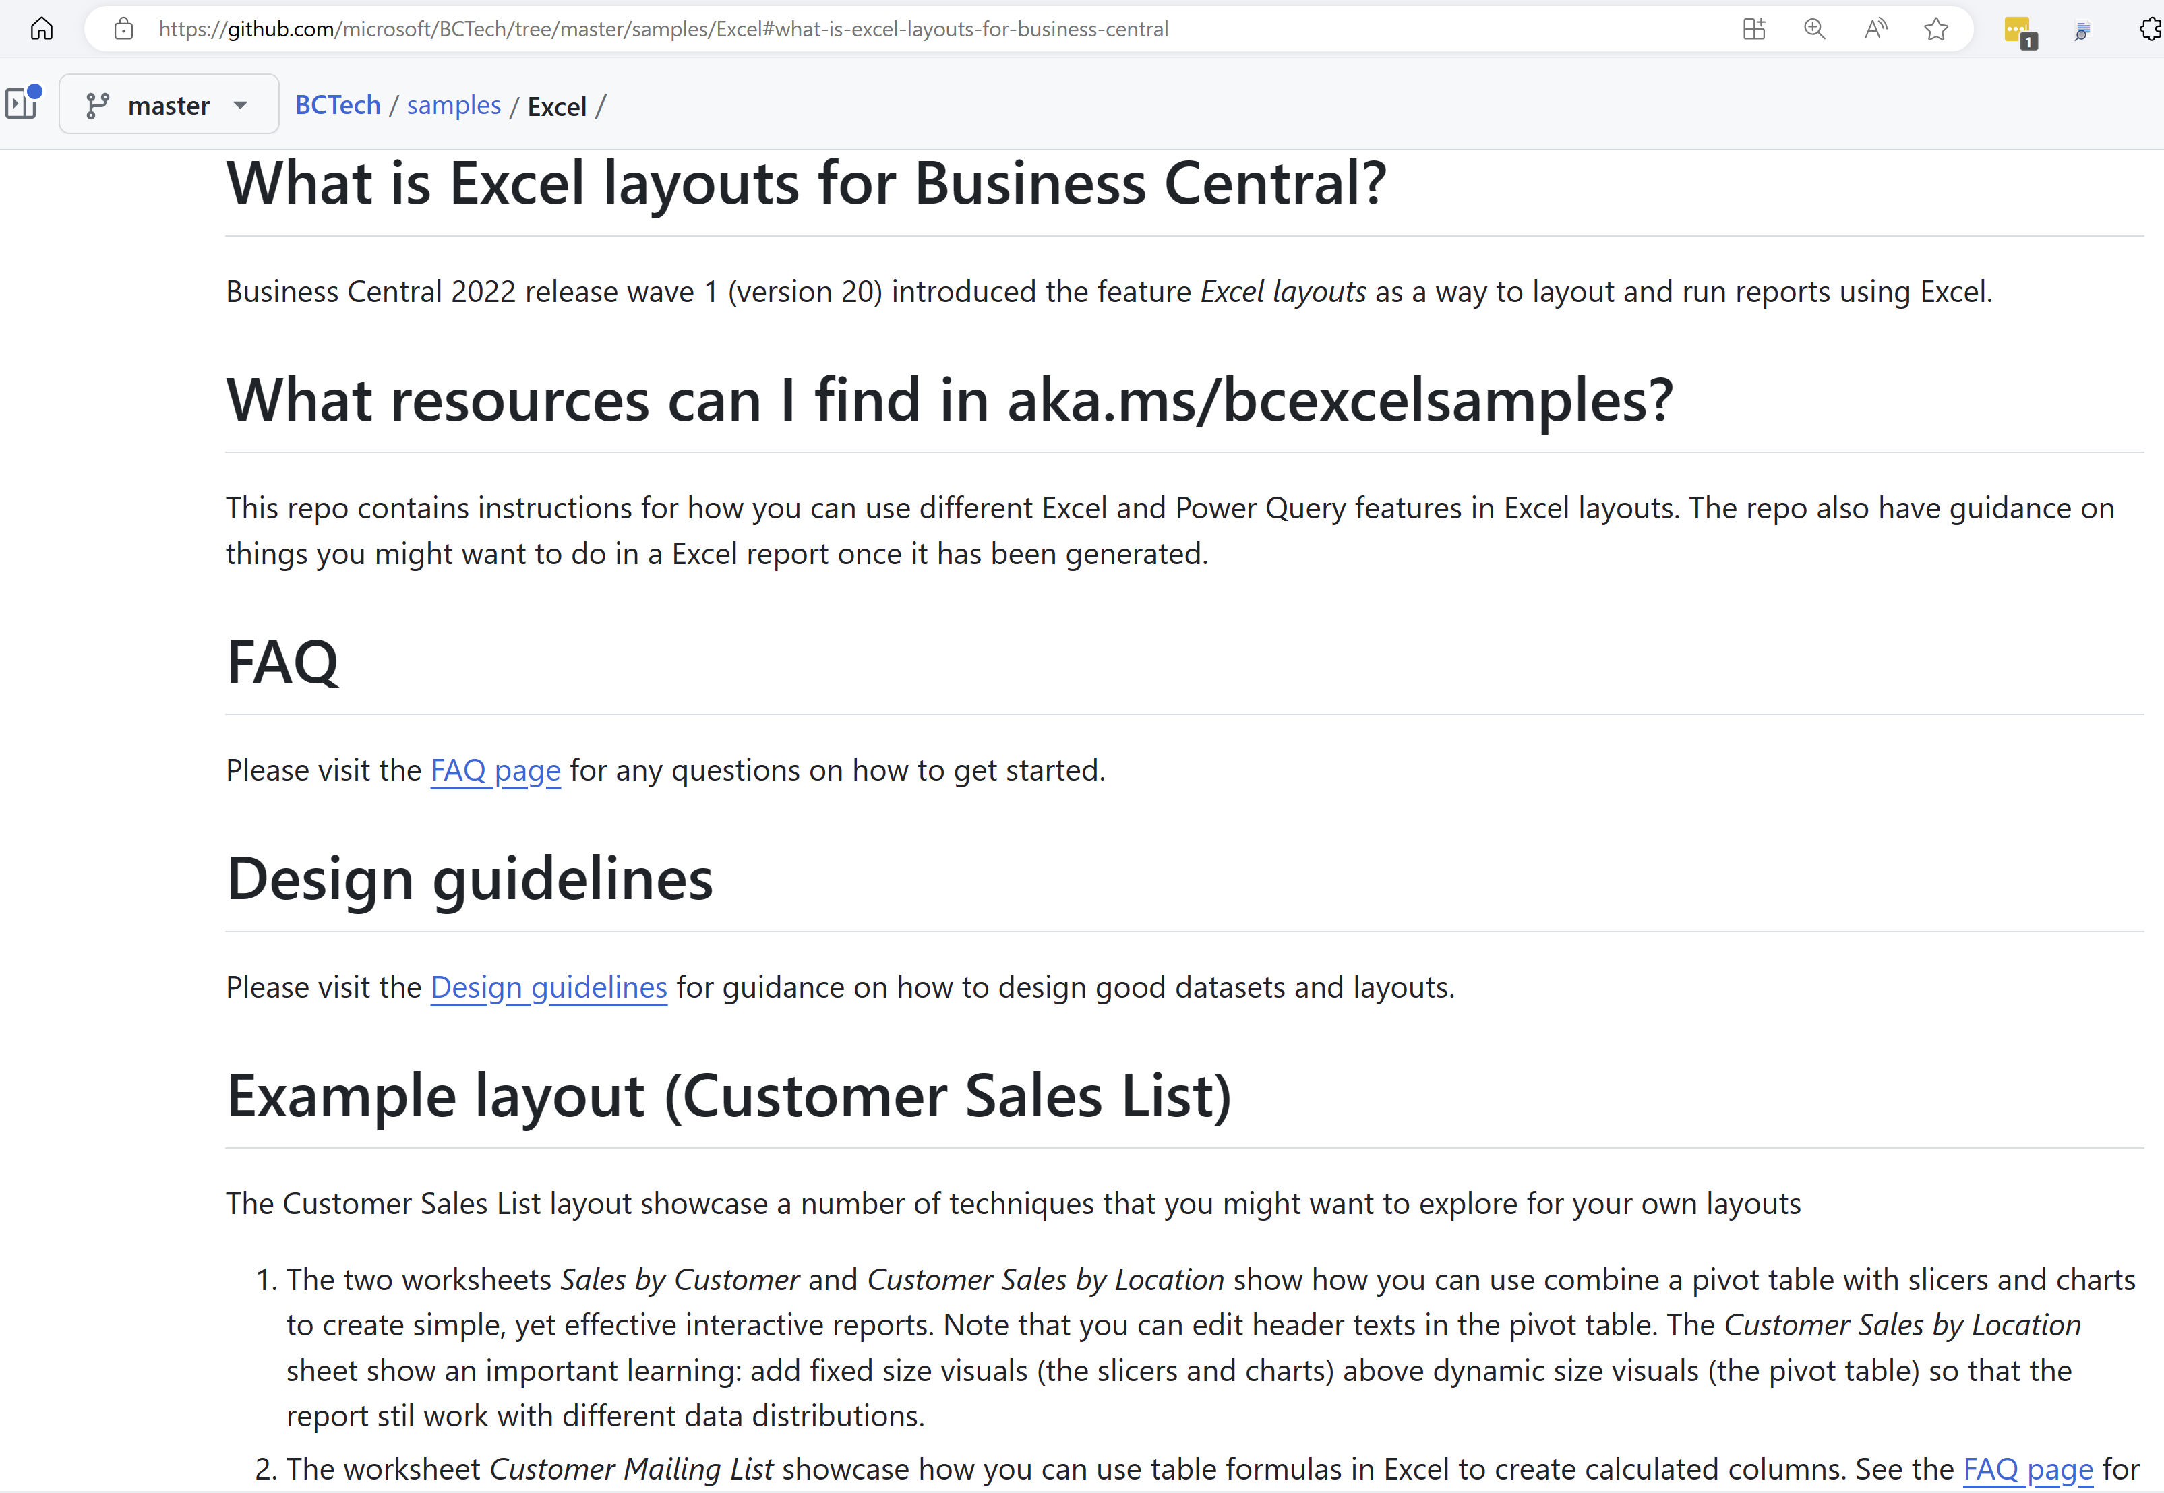
Want to learn through examples? aka.ms/ bcExcelSamples

Slide 29
Go-dos
Start providing Excel reports for analytics
Deliver multi-language Excel reports in your apps
Explore Excel copilot
Know the BI triangle
Learn it with your users

Slide 30


Other relevant launch event sessions (server architecture)
What's new: AL runtime and database
What's new: Web services

Slide 31

Other relevant launch event sessions (for developers)
What's new: Visual Studio Code and AL Development
What's new: Key updates in our learning content (documentation) for developers
What's new: Key updates in our learning content (documentation) for systems architects and integration developers

Slide 32

General Business Central resource
Have a question?
aka.ms/BCYammer
Join the conversation
@MSDyn365BC
Looking for resources?
aka.ms/BCAll
Follow on LinkedIn
aka.ms/BCLinkedIn
Learn more!
Submit your ideas
aka.ms/BCIdeas
Join the office hours
aka.ms/BCOfficeHours

Slide 33
Thank you

